Slide 1




CONFUSED YOUTH
BORROWING BOOK AT THE LIBRARY

Slide 2






CONFUSED YOUTH
CONFUSED YOUTH TEAM
Indra
Gung Yoga
Genta
Kent
ITB STIKOM BALI
ITB STIKOM BALI
ITB STIKOM BALI
DNUI

Slide 3

CONFUSED YOUTH
PROJECT INTRODUCTION
Developed in the Java programming language. This is an application that helps users manage borrowing books at the library. Users can add book, member, borrowing and returning data.

Slide 4
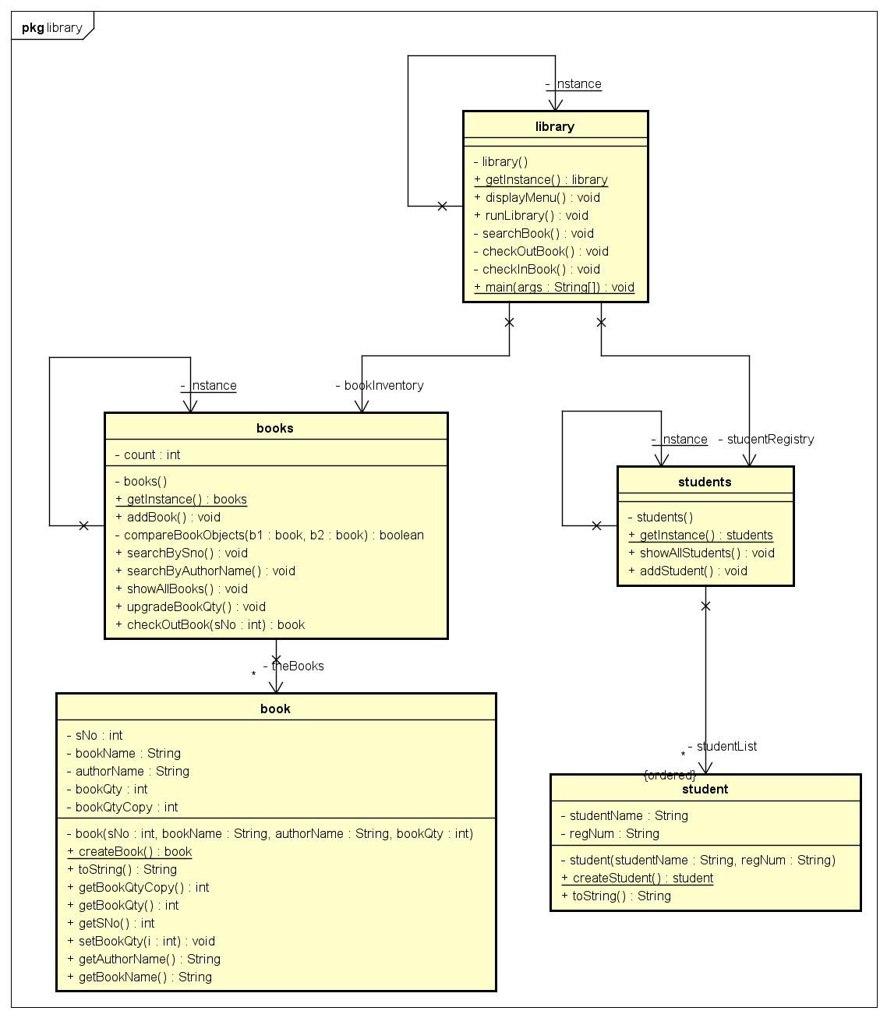
CONFUSED YOUTH
CLASS DIAGRAM

Slide 5
DESIGN PATTERN
SINGLETON PATTERN
THE SINGLETON PATTERN IS A CREATIONAL DESIGN PATTERN THAT RESTRICTS THE INSTANTIATION OF A CLASS TO A SINGLE INSTANCE AND PROVIDES A GLOBAL POINT OF ACCESS TO THAT INSTANCE. IT ENSURES THAT ONLY ONE INSTANCE OF A CLASS EXISTS IN THE SYSTEM AND PROVIDES A WAY TO ACCESS IT FROM ANYWHERE WITHIN THE CODEBASE.
THE SINGLETON PATTERN IS OFTEN USED IN SCENARIOS WHERE THERE IS A NEED FOR A SINGLE, SHARED RESOURCE, SUCH AS A DATABASE CONNECTION, FILE SYSTEM, LOGGER, OR THREAD POOL. BY USING THE SINGLETON PATTERN, YOU CAN ENSURE THAT MULTIPLE INSTANCES OF THESE RESOURCES ARE NOT CREATED, WHICH CAN HELP WITH RESOURCE MANAGEMENT AND COORDINATION.
DESIGN PATTERN

Slide 6
CONFUSED YOUTH
LIBRARY PATTERN CODE

Slide 7
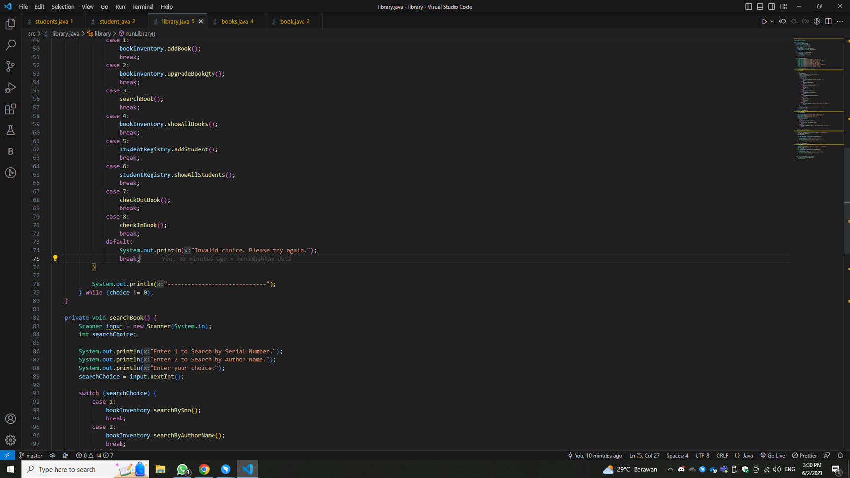
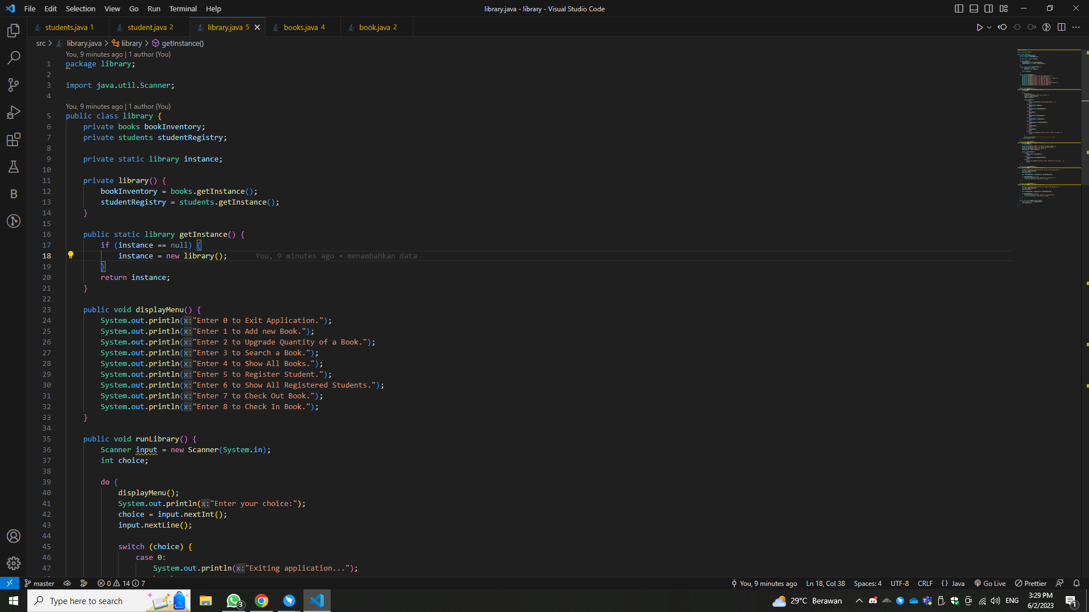
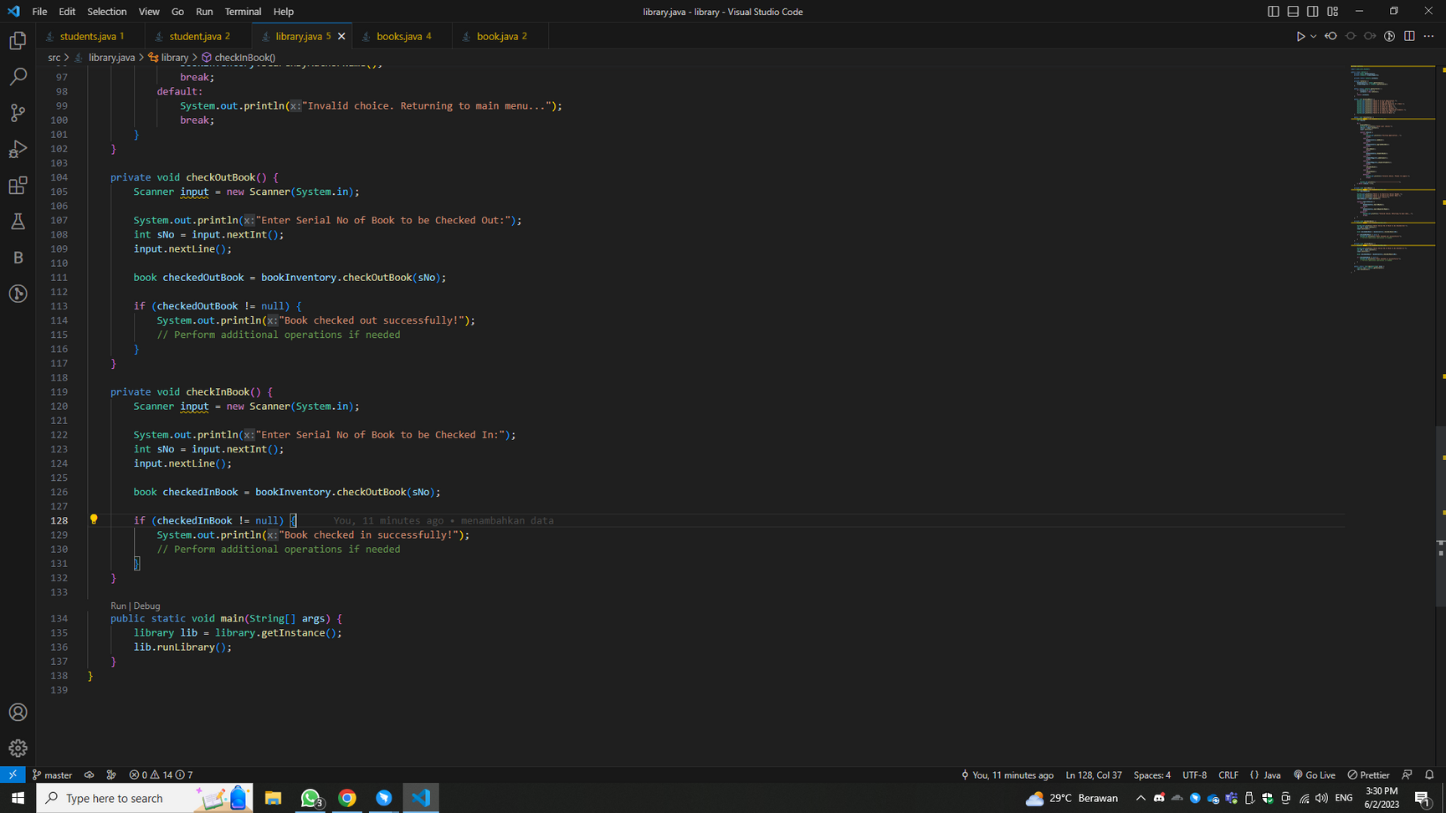
THIS CLASS REPRESENTS THE LIBRARY MANAGEMENT SYSTEM. IT CONTROLS THE FLOW OF THE APPLICATION AND INTERACTS WITH THE BOOKS AND STUDENTS CLASSES.
THE CLASS FOLLOWS THE SINGLETON PATTERN, ENSURING THAT ONLY ONE INSTANCE OF THE LIBRARY CLASS EXISTS.
THE RUNLIBRARY() METHOD STARTS THE LIBRARY MANAGEMENT SYSTEM AND DISPLAYS A MENU FOR VARIOUS OPERATIONS.
THE CLASS PROVIDES METHODS FOR ADDING BOOKS, UPGRADING BOOK QUANTITIES, SEARCHING BOOKS, DISPLAYING ALL BOOKS, REGISTERING STUDENTS, DISPLAYING REGISTERED STUDENTS, CHECKING OUT BOOKS, AND CHECKING IN BOOKS.
LIBRARY.JAVA

Slide 8
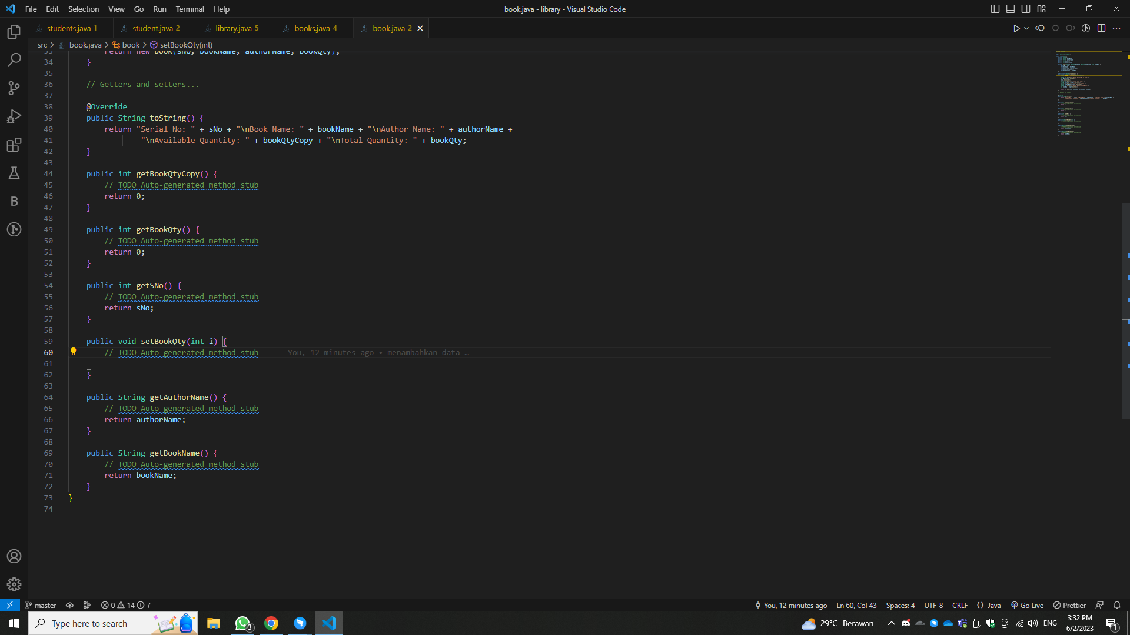
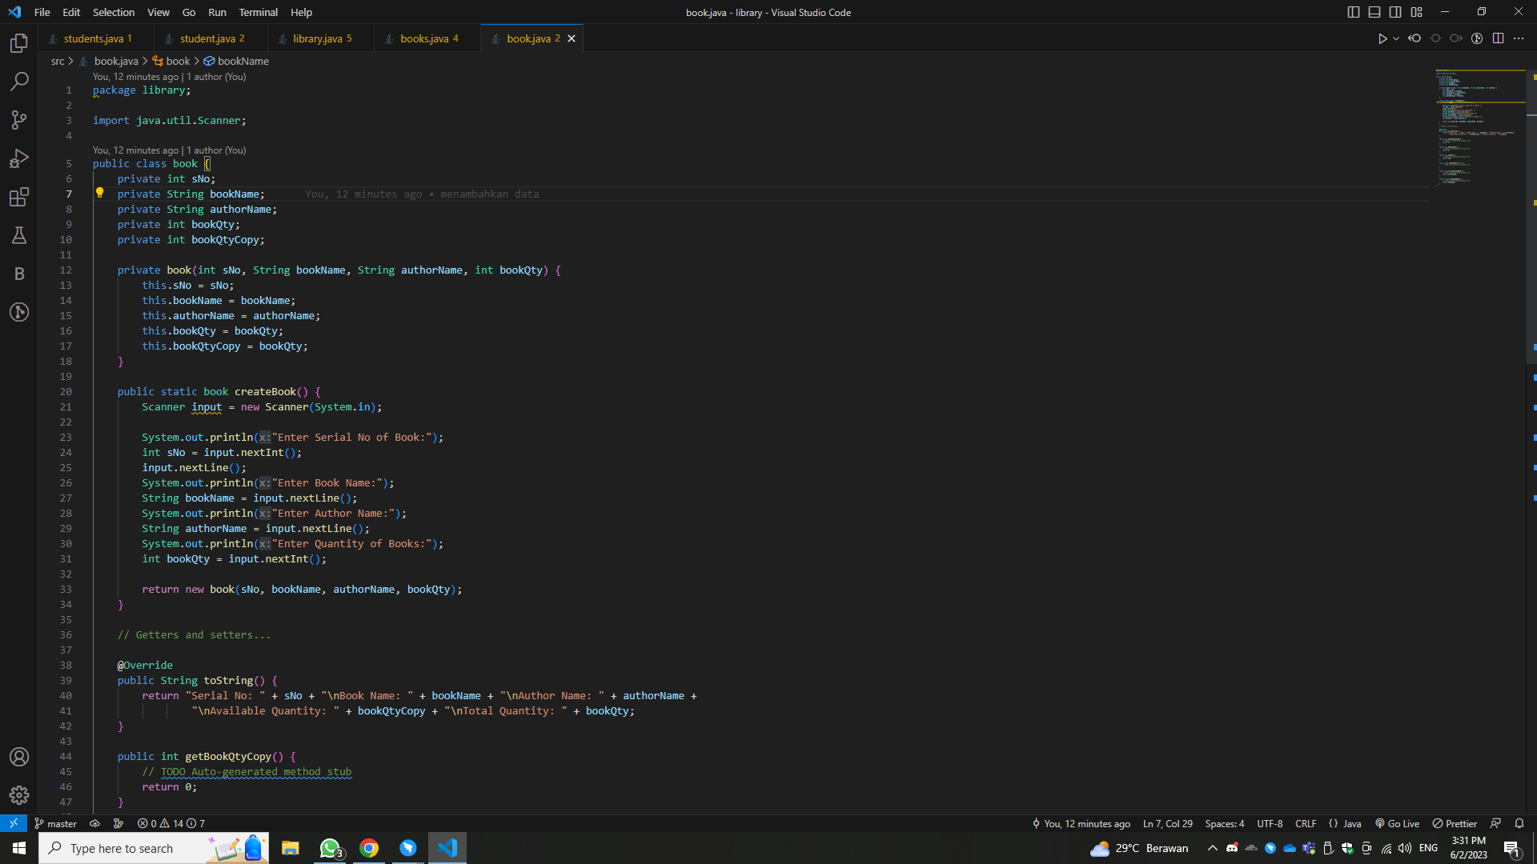
BOOK.JAVA
THIS CLASS REPRESENTS A BOOK IN THE LIBRARY. IT HAS PRIVATE FIELDS FOR THE SERIAL NUMBER, BOOK NAME, AUTHOR NAME, BOOK QUANTITY, AND AVAILABLE BOOK QUANTITY.
THE CONSTRUCTOR IS PRIVATE TO PREVENT DIRECT INSTANTIATION. INSTEAD, THE ADDBOOK() METHOD IN THE BOOKS CLASS IS RESPONSIBLE FOR CREATING BOOK OBJECTS.
THE CLASS PROVIDES GETTERS AND SETTERS FOR ACCESSING AND MODIFYING THE BOOK DETAILS.

Slide 9
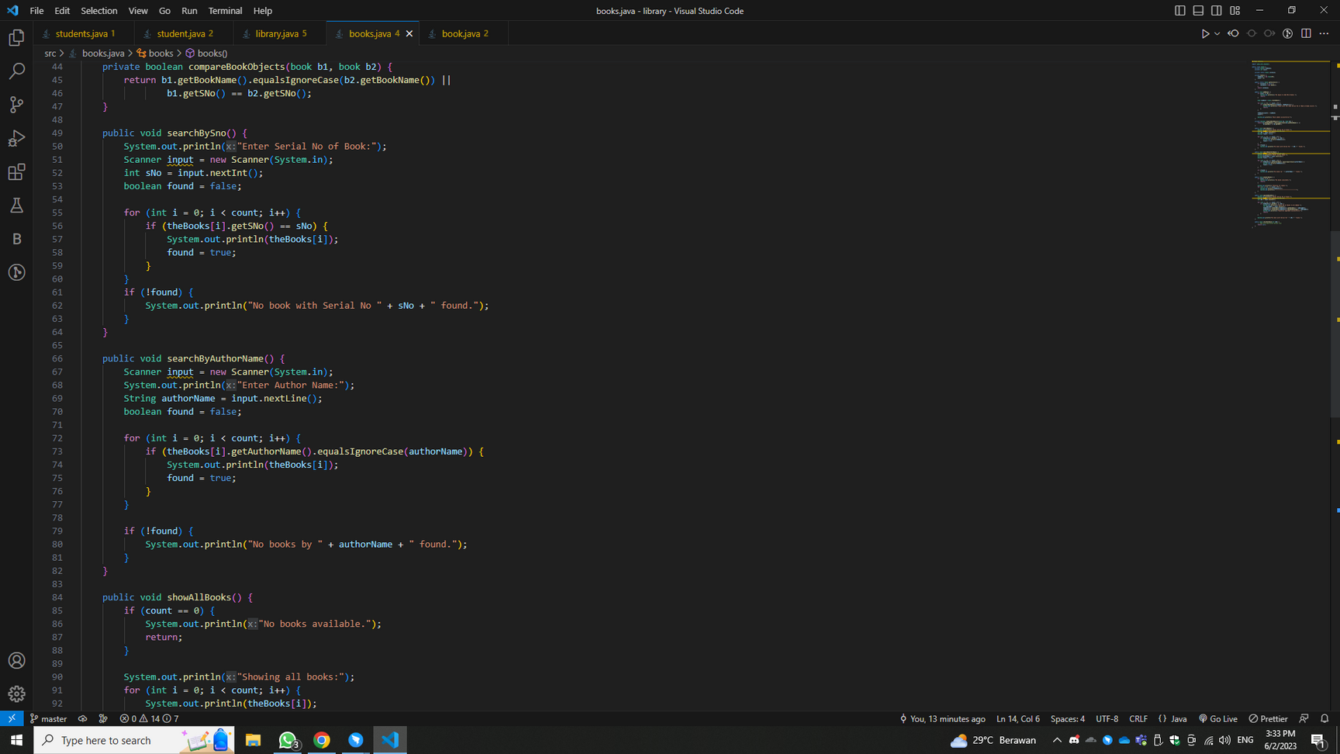
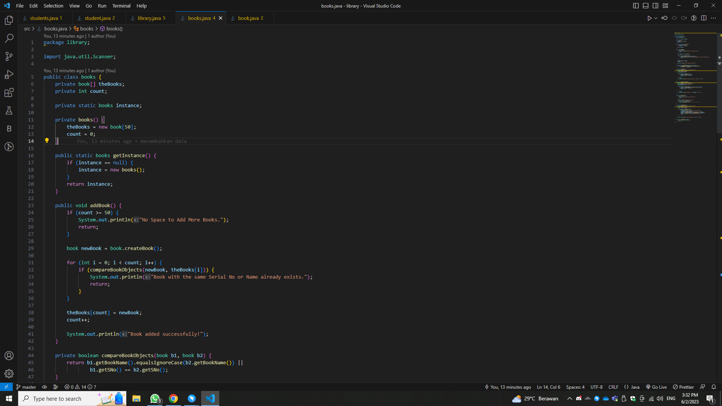
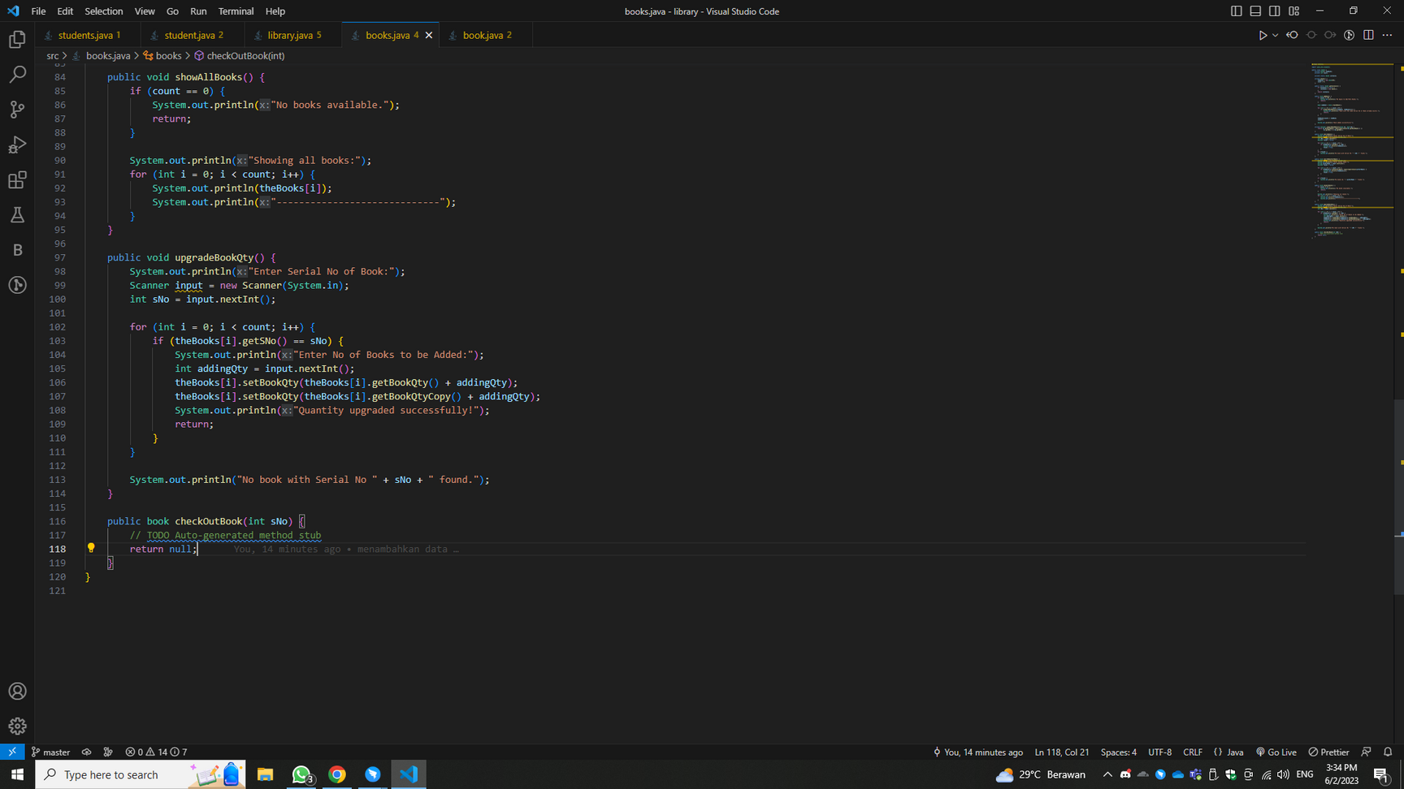
THIS CLASS REPRESENTS THE BOOK INVENTORY IN THE LIBRARY. IT MAINTAINS AN ARRAY OF BOOK OBJECTS AND A COUNT OF THE NUMBER OF BOOKS.
THE CLASS FOLLOWS THE SINGLETON PATTERN, ENSURING THAT ONLY ONE INSTANCE OF THE BOOKS CLASS EXISTS.
THE ADDBOOK() METHOD ADDS A BOOK TO THE INVENTORY AFTER CHECKING FOR DUPLICATES BASED ON BOOK NAME AND SERIAL NUMBER.
THE CLASS PROVIDES METHODS FOR SEARCHING BOOKS BY SERIAL NUMBER AND AUTHOR NAME, UPGRADING THE QUANTITY OF A BOOK, AND DISPLAYING ALL BOOKS IN THE INVENTORY.
BOOKS.JAVA

Slide 10
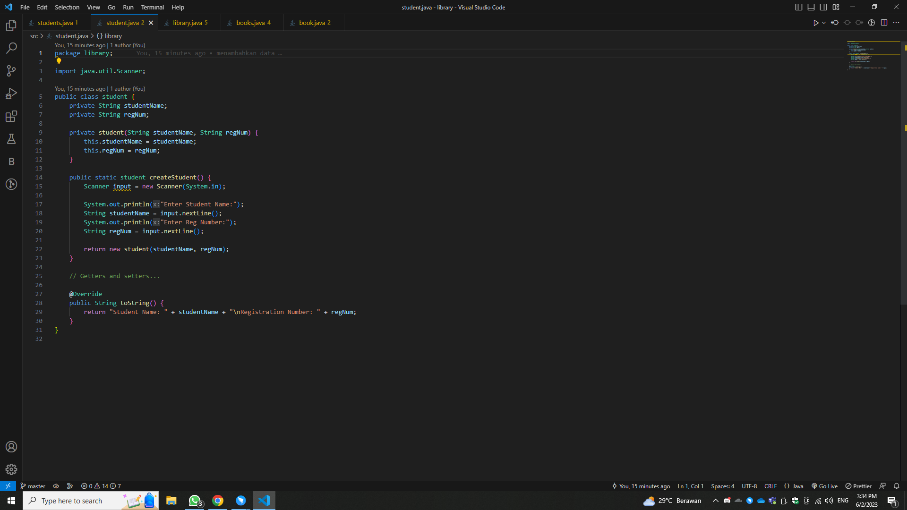
STUDENT.JAVA
THIS CLASS REPRESENTS A STUDENT IN THE LIBRARY. IT HAS PRIVATE FIELDS FOR THE STUDENT'S NAME AND REGISTRATION NUMBER.
THE CONSTRUCTOR IS PRIVATE TO PREVENT DIRECT INSTANTIATION. INSTEAD, THE ADDSTUDENT() METHOD IN THE STUDENTS CLASS IS RESPONSIBLE FOR CREATING STUDENT OBJECTS.
THE CLASS PROVIDES GETTERS AND SETTERS FOR ACCESSING AND MODIFYING THE STUDENT DETAILS.

Slide 11
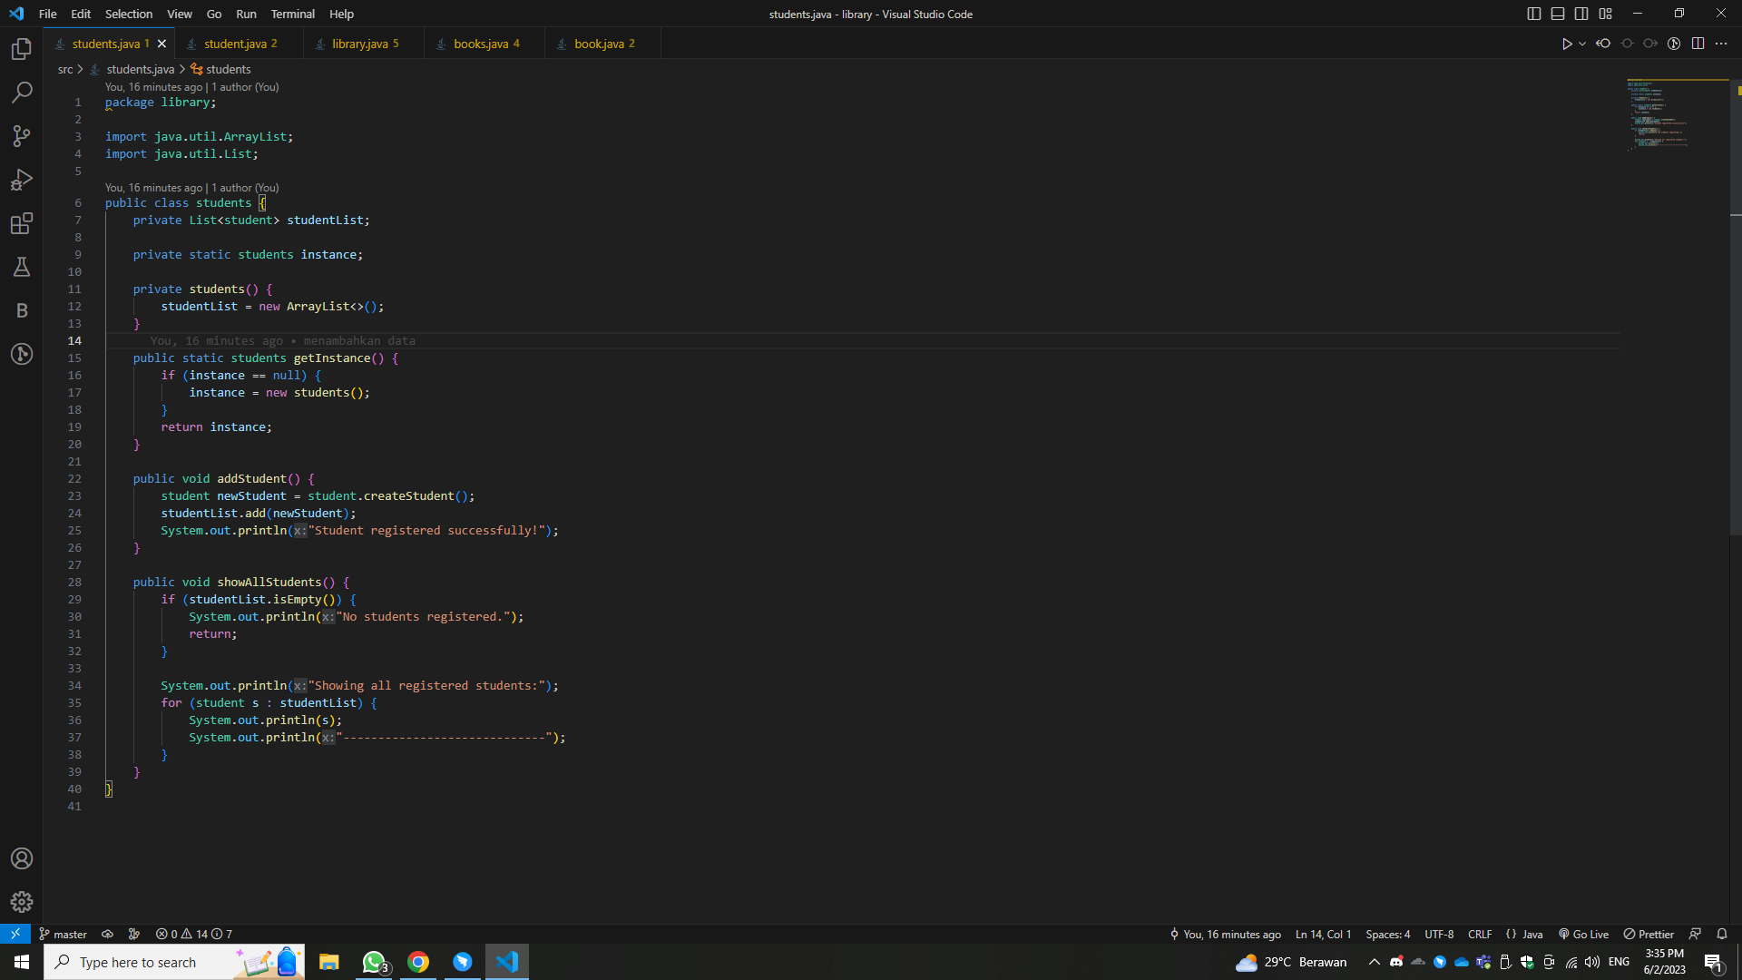
STUDENTS.JAVA
THIS CLASS REPRESENTS THE STUDENT REGISTRY IN THE LIBRARY. IT MAINTAINS A LIST OF STUDENT OBJECTS.
THE CLASS FOLLOWS THE SINGLETON PATTERN, ENSURING THAT ONLY ONE INSTANCE OF THE STUDENTS CLASS EXISTS.
THE ADDSTUDENT() METHOD ADDS A STUDENT TO THE REGISTRY.
THE CLASS PROVIDES A METHOD FOR DISPLAYING ALL REGISTERED STUDENTS.

Slide 12

SALFORD & CO.
THANK YOU

Slide 13
CONFUSED YOUTH
OUR
PROGRAM'S
VIDEOS
CONFUSED YOUTH TEAM

